Slide 1
Evan Pan, Mark Edwards, Sydnie Farrell

Slide 2
Elevator pitch
When you’re in your kitchen and don’t know what to cook, you can use the Meal Planner application to help you decide. By putting different ingredients in the search bar, you can find a list of recipes that you can make with that ingredient. You can easily select different recipes and see the ingredients needed, instructions for how to make it, and pictures.

Slide 3
Motivation for Development
Everyone needs to eat, so we wanted to make an application that would be helpful in providing new ways to make food using ingredients that you have. This is helpful for many purposes, for example:
Try new meal
Get inspired
Plan for future meals

Slide 4
User Story
AS A meal planner
WHEN I have an ingredient
I WANT to get a list of recipes to make with that ingredient
GIVEN I have an ingredient
WHEN I enter the ingredient in a Search
THEN I will see a list of recipes that use that ingredient
WHEN I select one of the recipes
THEN I can see the ingredients needed to make the recipe
WHEN I select one of the recipes
THEN I can see the instructions for how to make the recipe
WHEN I select one of the recipes
THEN I can see additional photos of that recipe

Slide 5
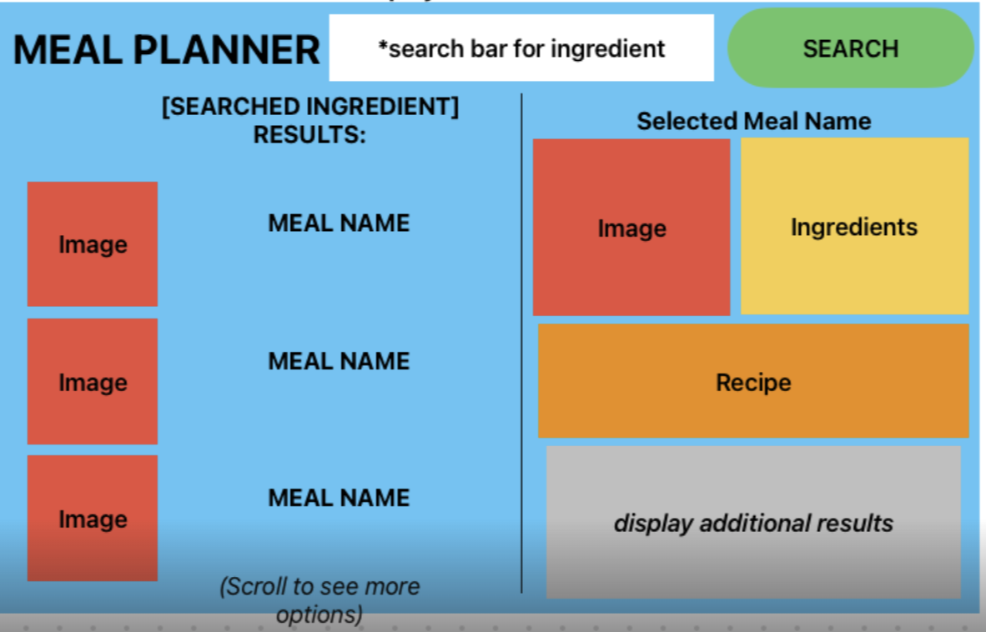
Task Breakdown
Evan: Image(right), Ingredients, Recipe
Mark: Meal List, Local Storage
Sydnie: Nav Bar, Additional Results, Layout

Slide 6

Demo

Slide 7
Challenges & Successes
Challenges
Git conflicts when merging
API documentation
Consistent Layout and Design
Successes
Initial Planning and Wireframing
Managing the project in Github (issues)
Time management

Slide 8
Technologies Used
HTML5 semantic tags,
CSS3
JavaScript
jQuery
Bootstrap
MealDb API
Google Search JSON API
Font Awesome
Google Fonts
Deployed using github pages.
Postman (check API responses)

Slide 9
Directions for Future Development
Save meals for future planning, click a button in the nav bar to see saved meals.
Expanded Google Search results, include other recipe options.
Update/polish layout
Integrate other useful API’s such as a map to see nearby stores with needed ingredients.

Slide 10
Links
Deployed
GitHub Repo

